Slide 1
“cortex”
Ashley Coffin
Undergraduate Research day
Saturday April 2, 2016

Slide 2

University Theatre Presents
Young Choreographers’ Showcase
School of Dance Coordinators
Austin Hartel, Ilya Kozadayev
Mentor
Ms. Rebecca Herrin
“Cortex” by Ashley Coffin
Music: “Brim” by Olafur Arnalds
Lighting Design: Trevor Harris
Costume: Lauren Carmen
Dancers: Brittany Bonefas, Maggie Brockschmidt, Megan Doyle, Bailey Evans, Lauren Peterson

Slide 3
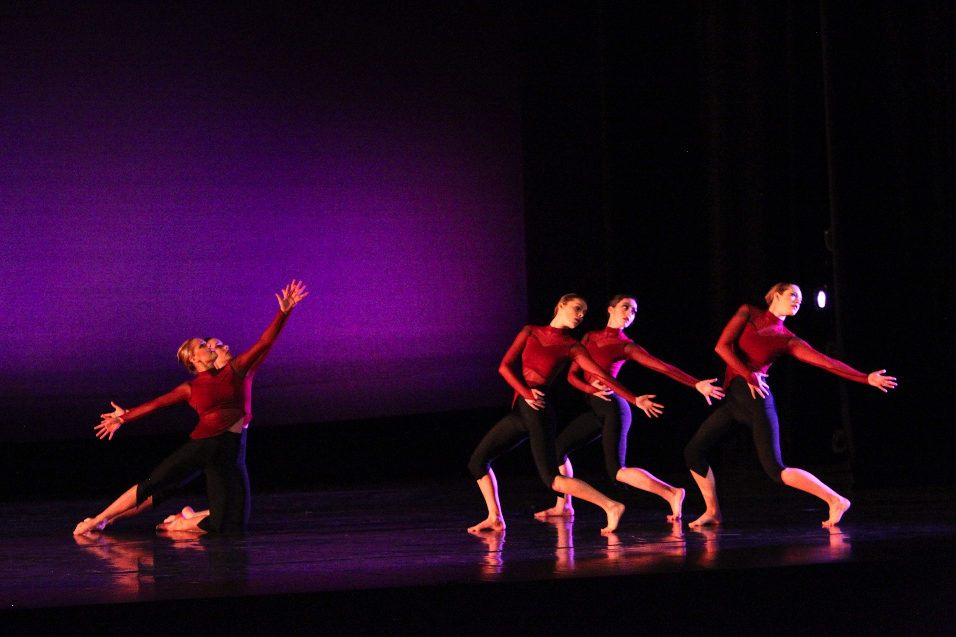
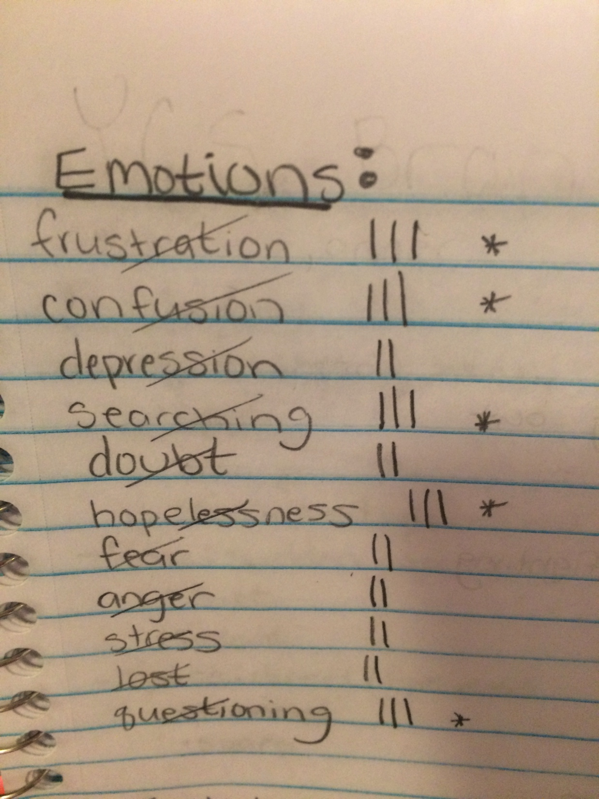
The Concept
The dancers symbolized different aspects of a mind that are cohesively struggling towards a goal that has not yet been reached.
-hopeless
-confusion
-frustration
-searching
-questioning
Photo by: Noor Eemaan Jaffery

Slide 4
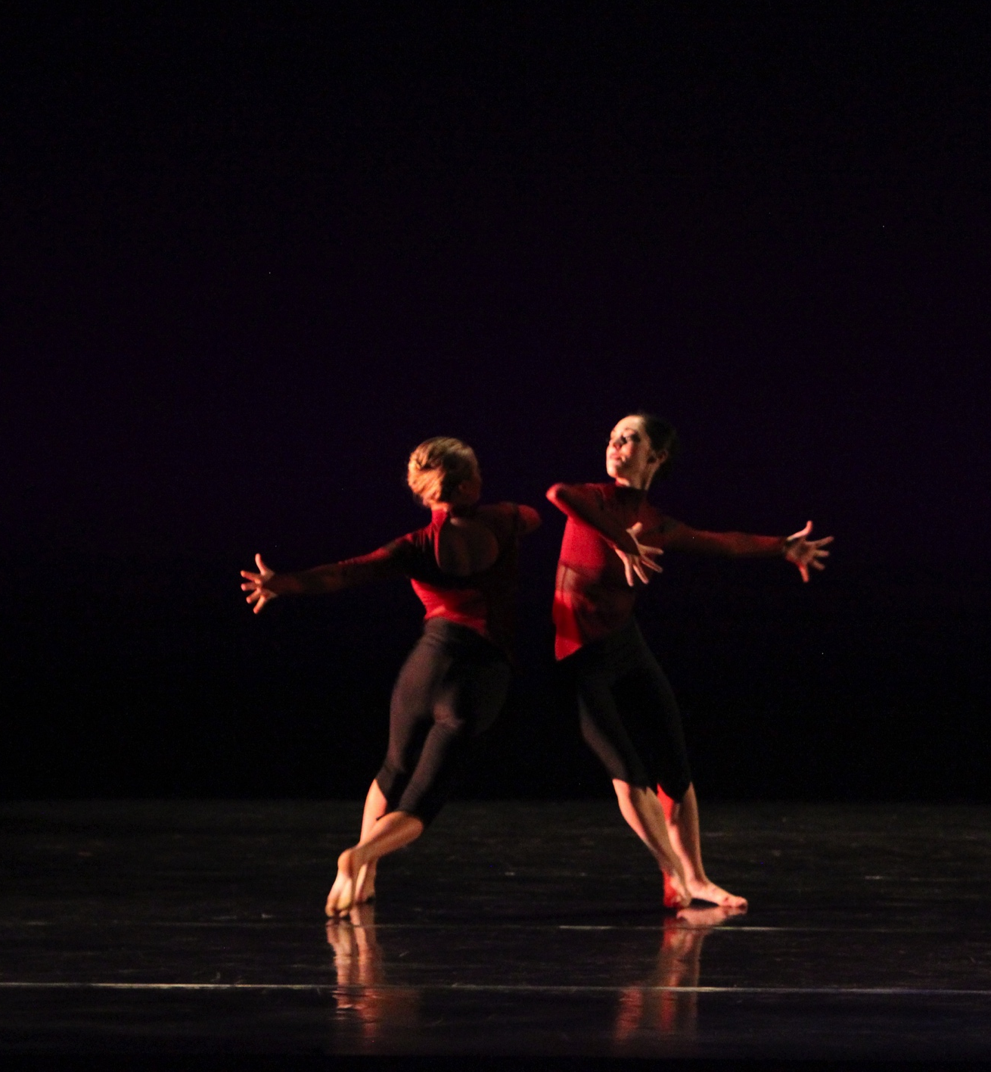
The Title: “Cortex”
Cortex Definition:
part of the brain that plays a key role in memory, attention, perception, awareness, thought, emotions, and consciousness
Vortex Definition:
something that resembles a whirlwind, a circular motion that tends to form and draw towards a cavity or vacuum
Photo by: Noor Eemaan Jaffery

Slide 5

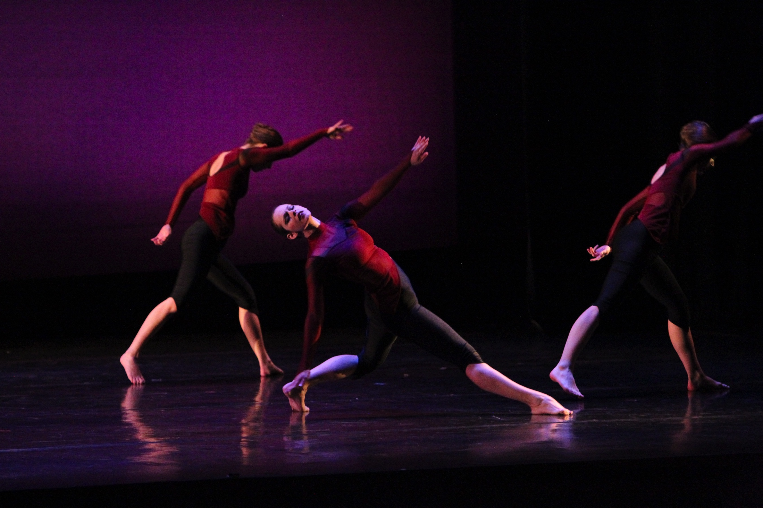
The Music
Option #1: “Abstract Instrumental Music”
by Creators & Inventors
Option #3: “Brim” by Olafur Arnalds
Option #2: “Take Flight” by Lindsey Stirling
Photo by: Kasey Allee-Foreman

Slide 6
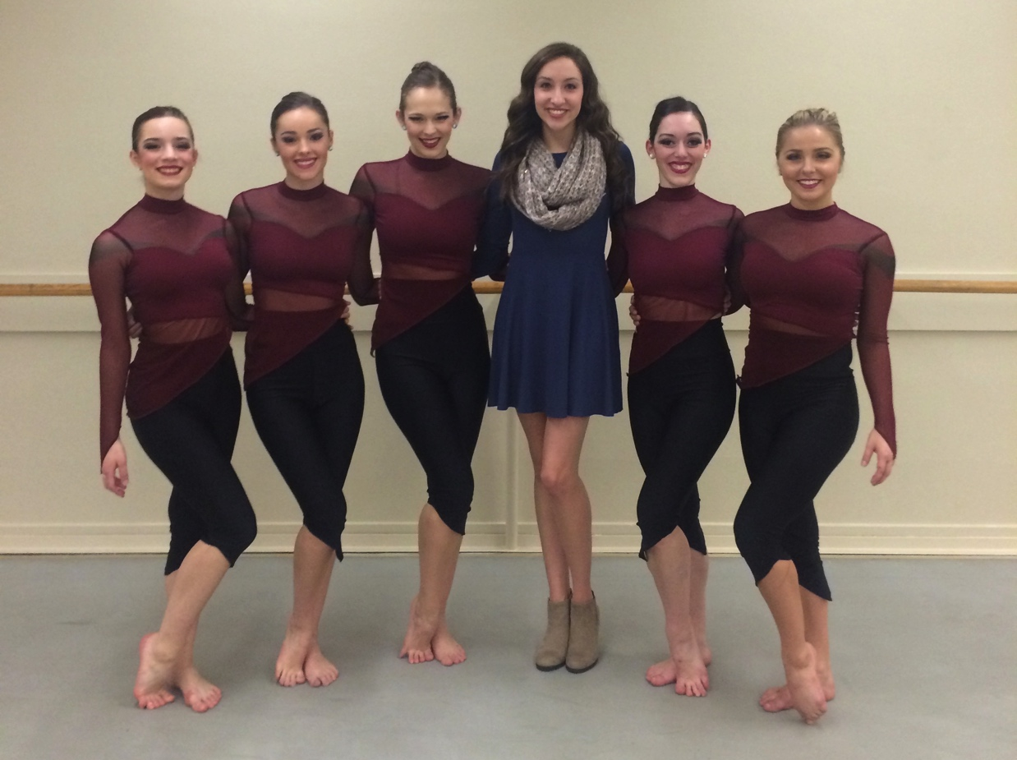
The Audition

Slide 7
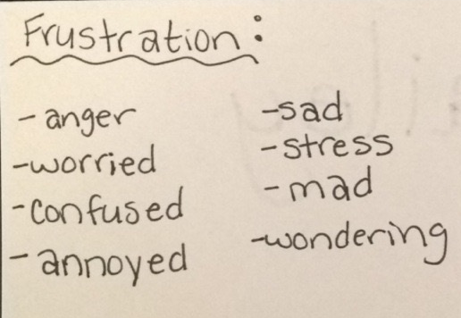
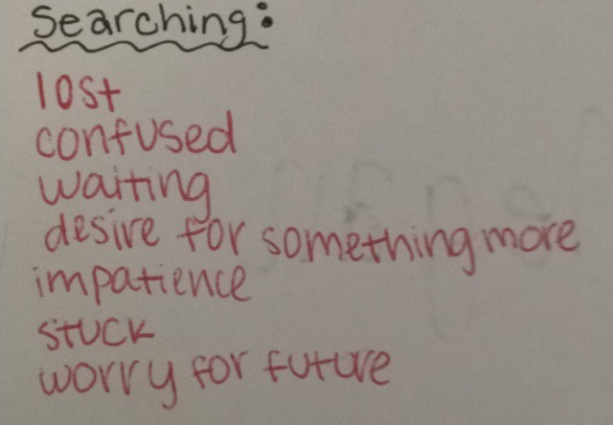
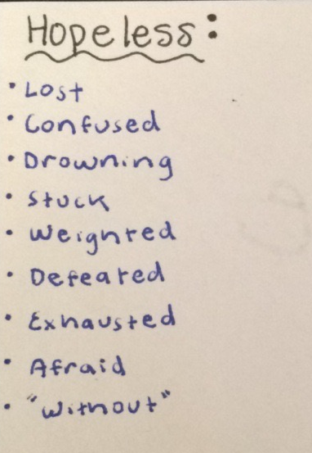
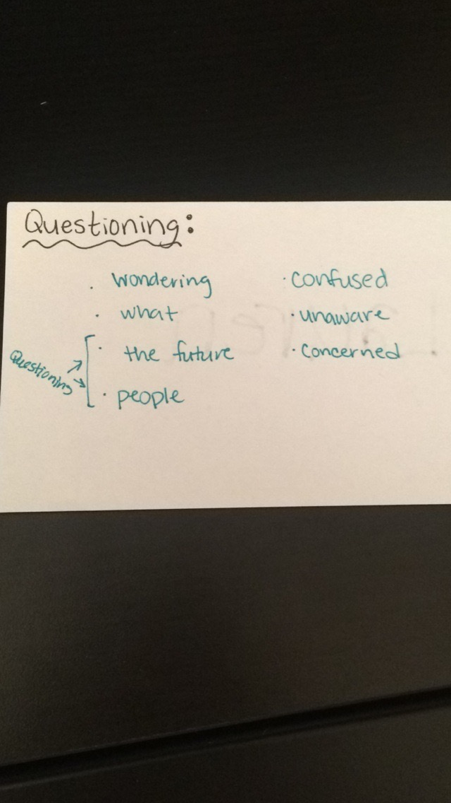
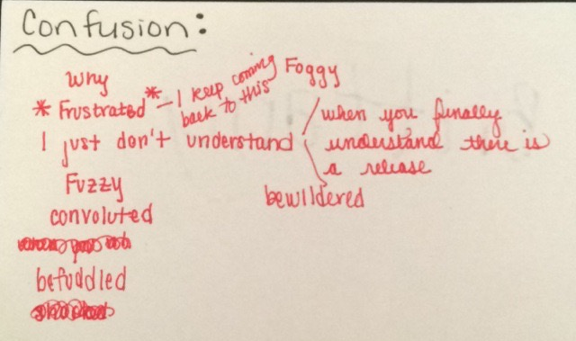
The Rehearsal Process: first Meeting

Slide 8
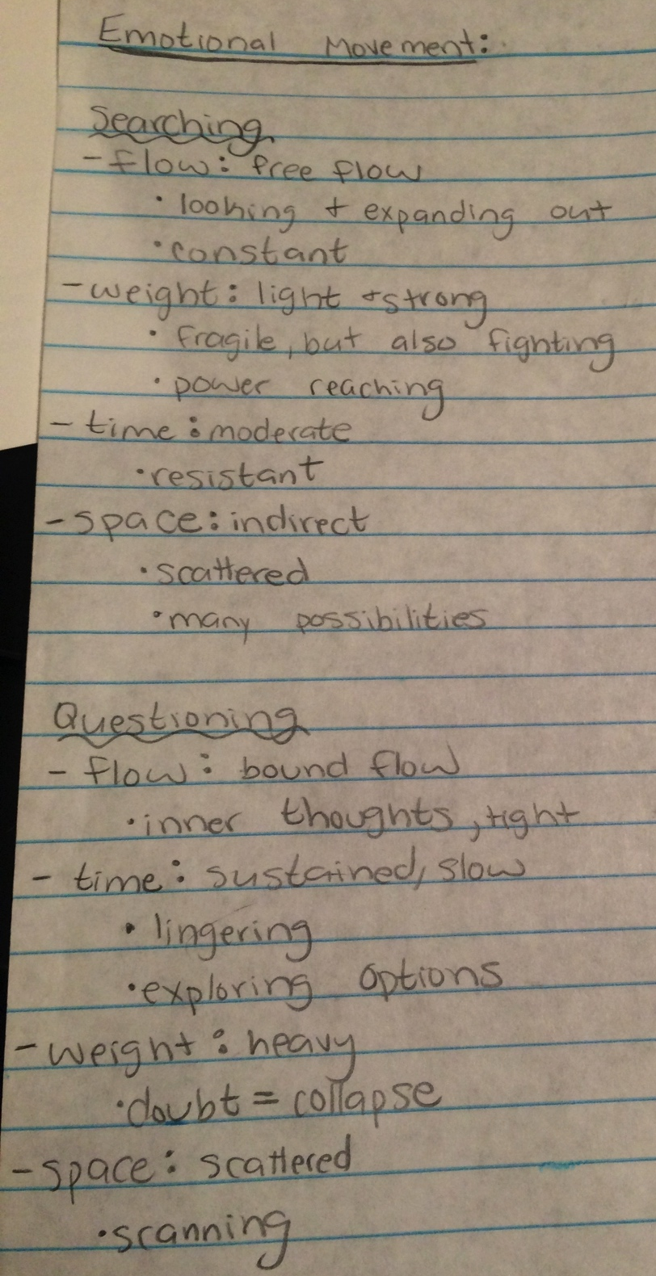
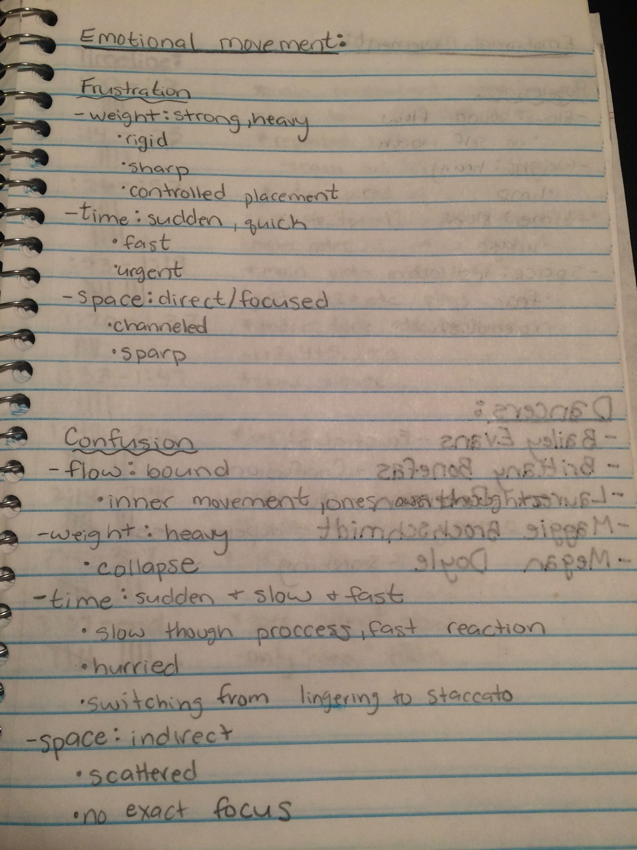
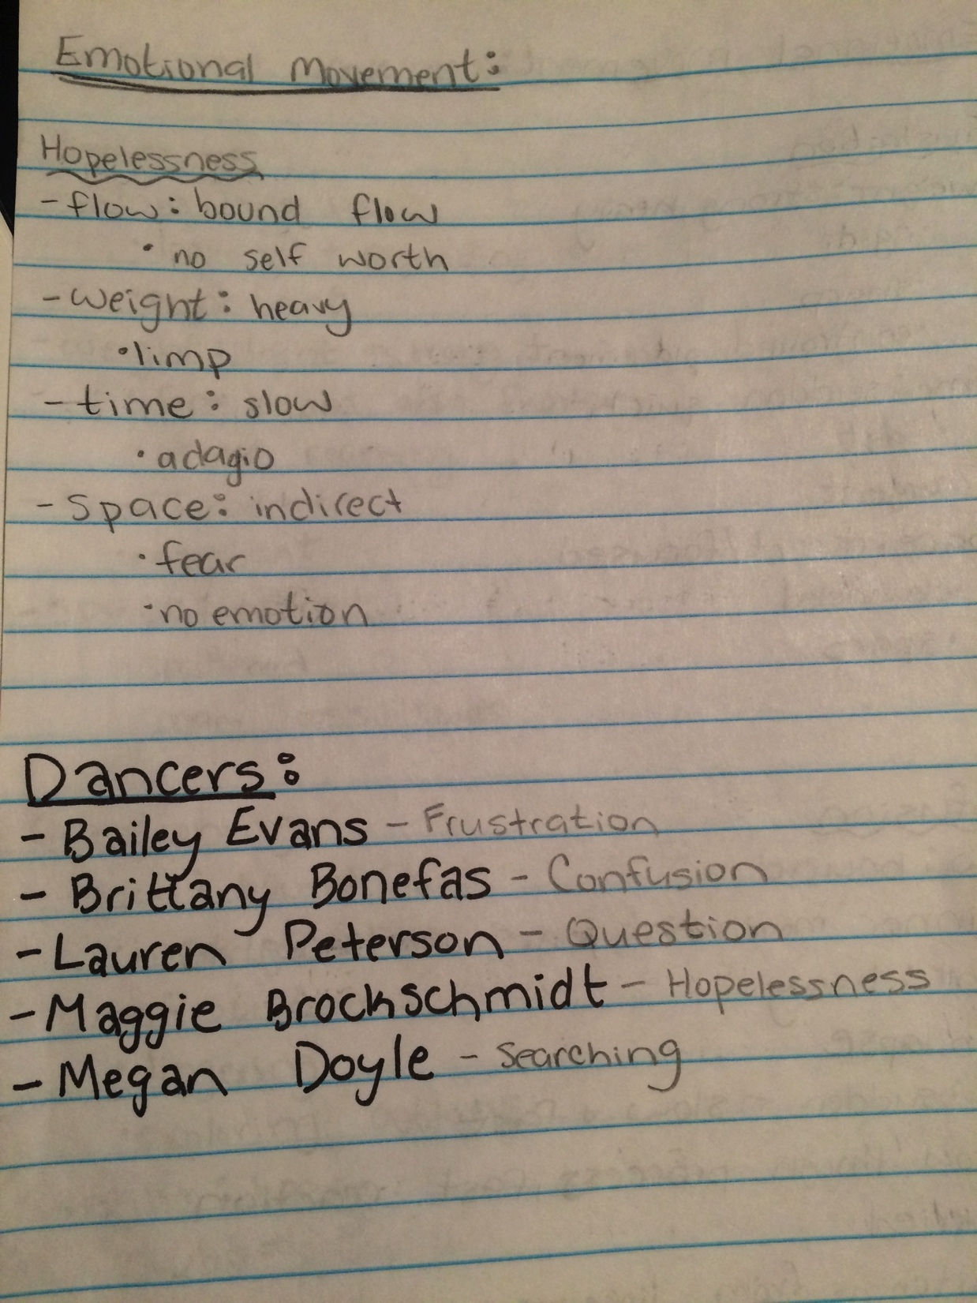
The Rehearsal Process: Concept becomes Movement

Slide 9
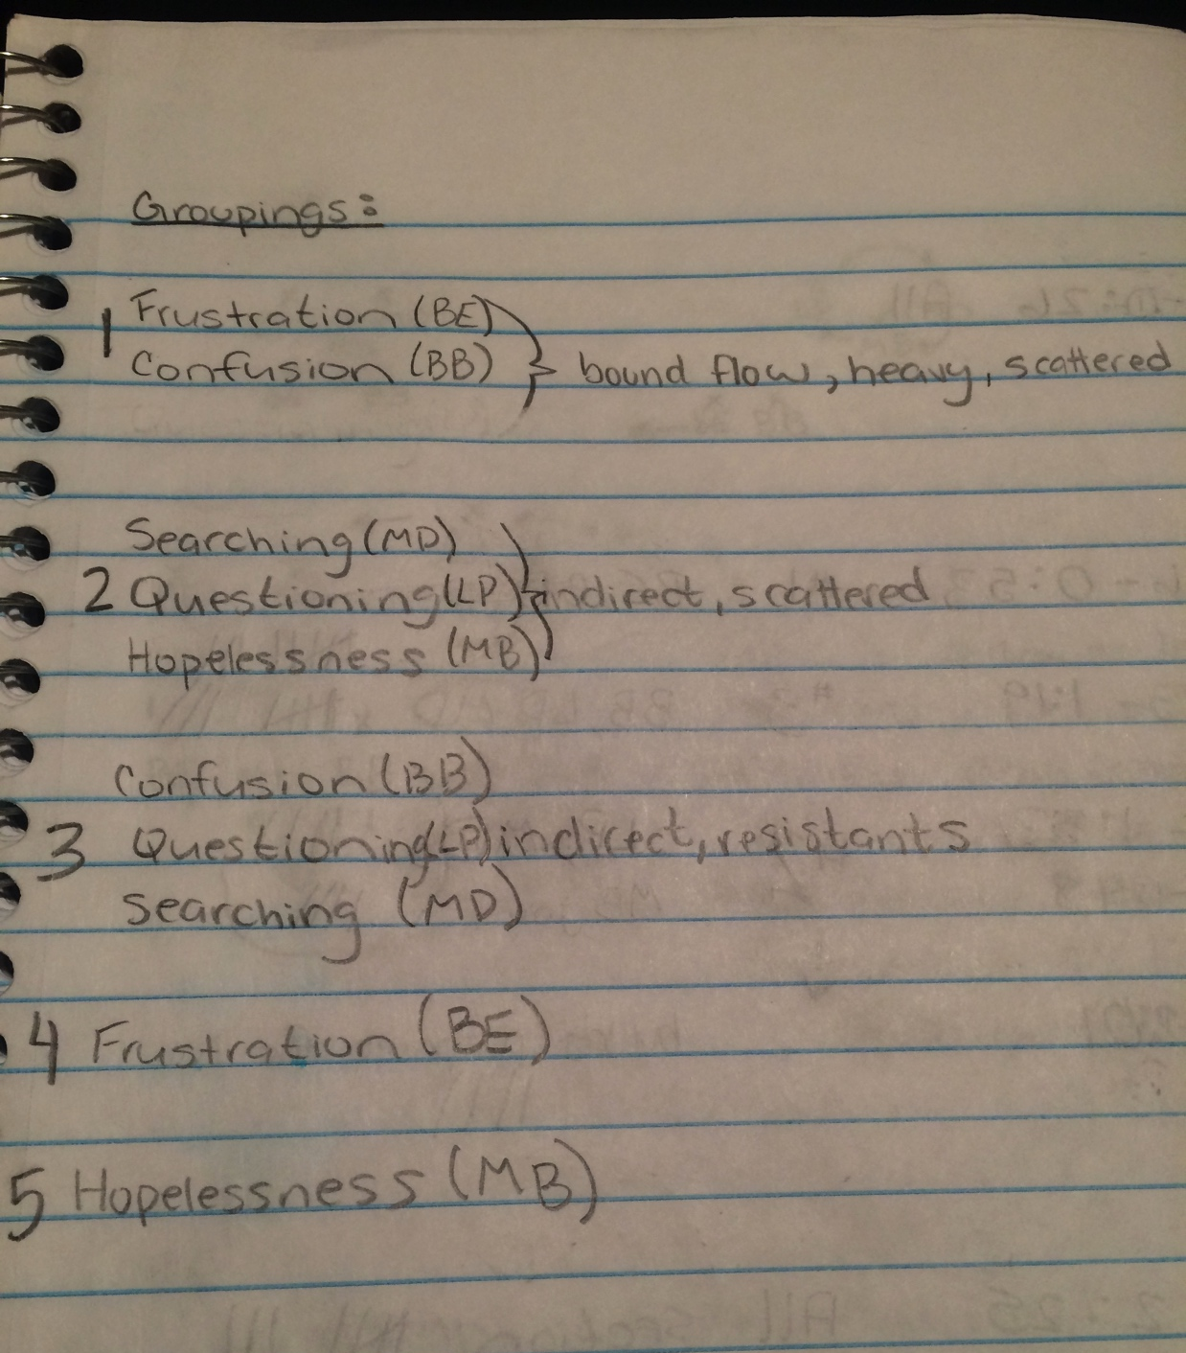
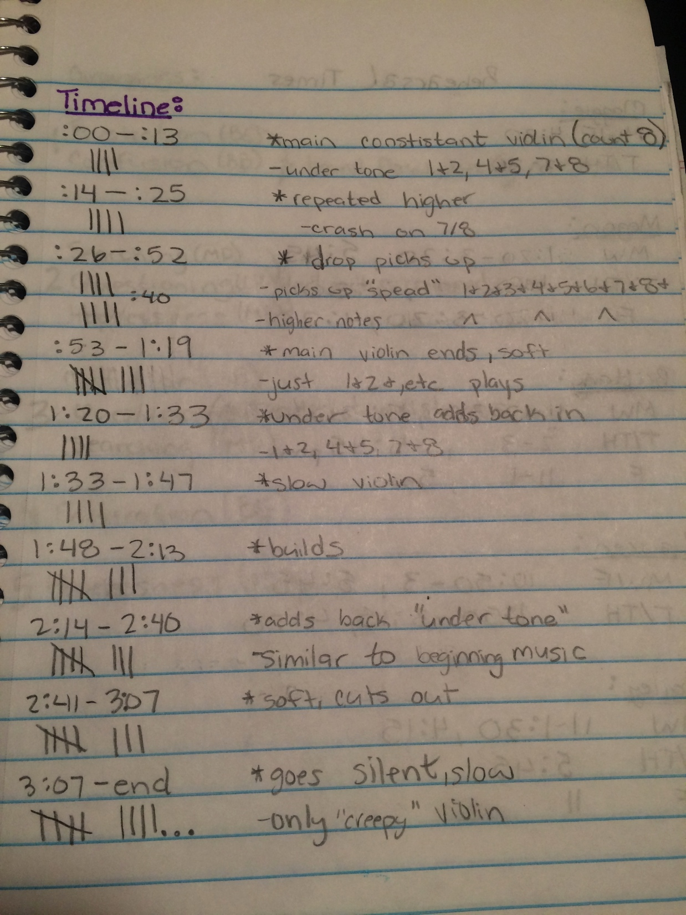
The Rehearsal Process: Choreography
Emotional/Conceptual Inspiration:
Music Inspiration:

Slide 10
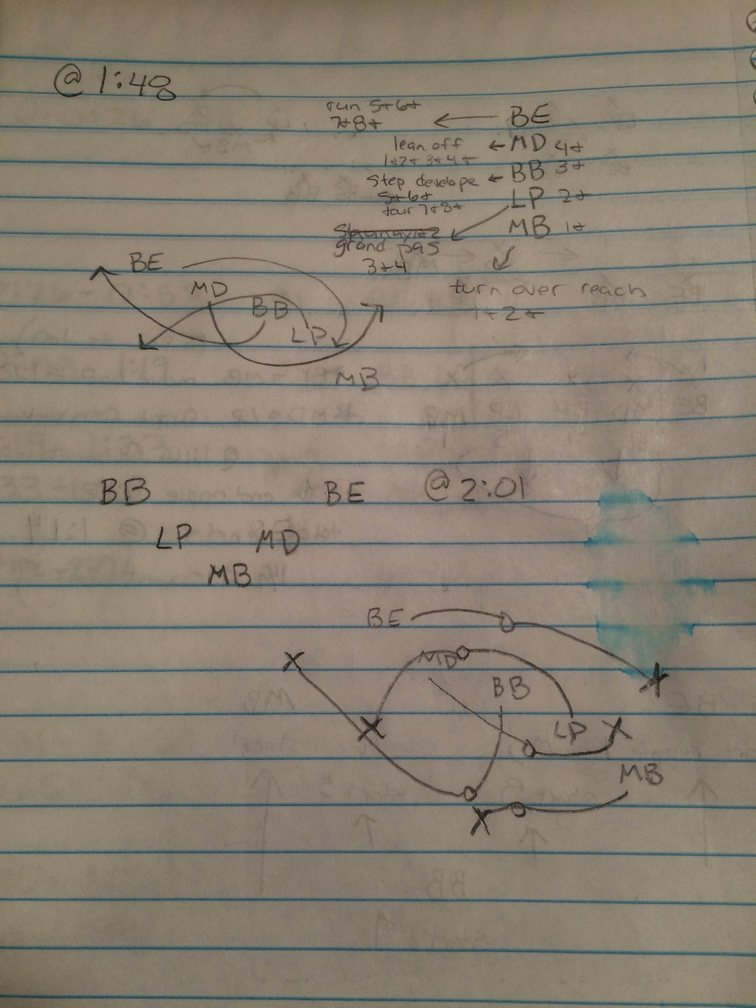
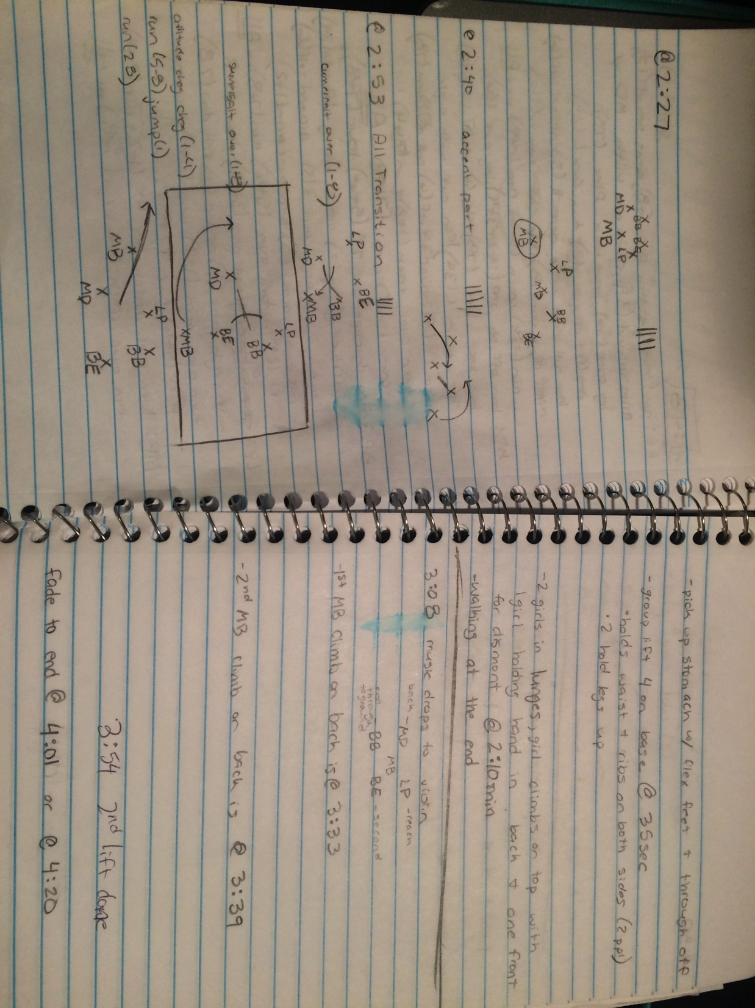
The Rehearsal Process: Choreography
Floor Patterns:

Slide 11
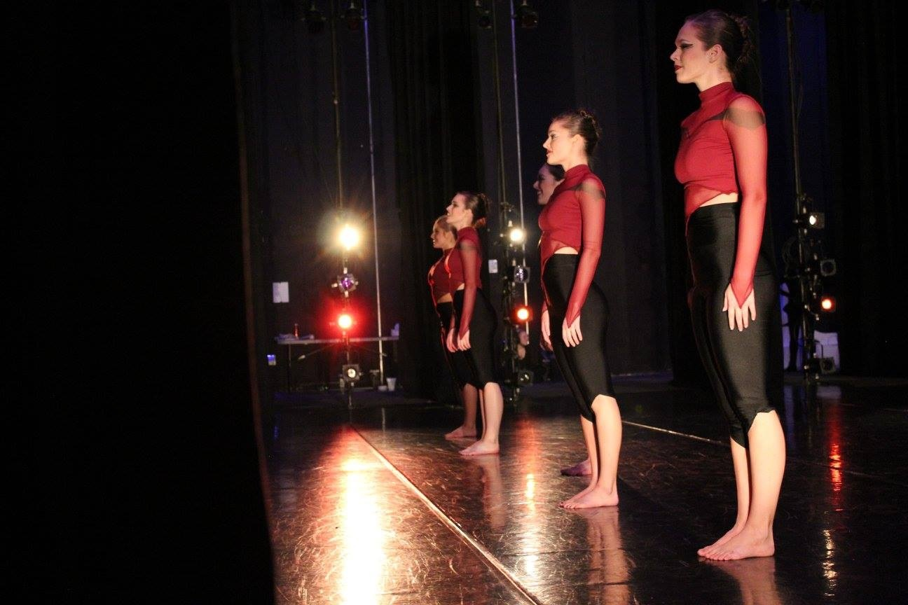
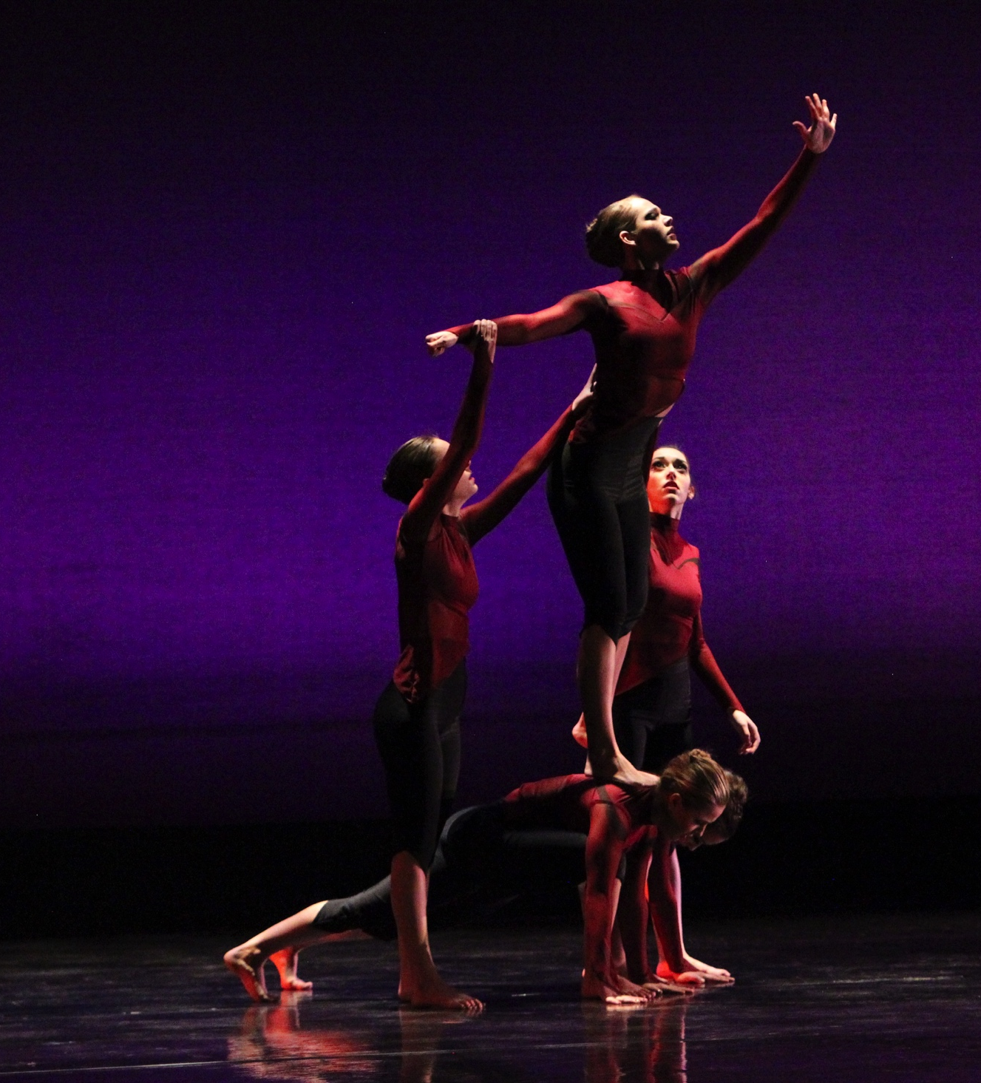
The Rehearsal Process: Choreography
Dancer Inspiration:
Photo by: Lauren Carmen
1st and 2nd Adjudication:
-the development of the piece continues
-slight change in concept
Photo by: Noor Eemaan Jaffery

Slide 12
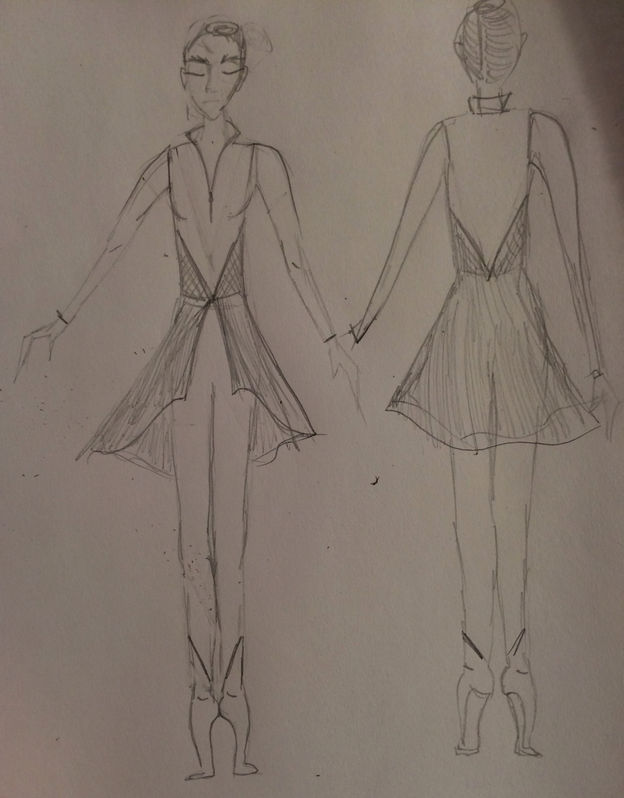
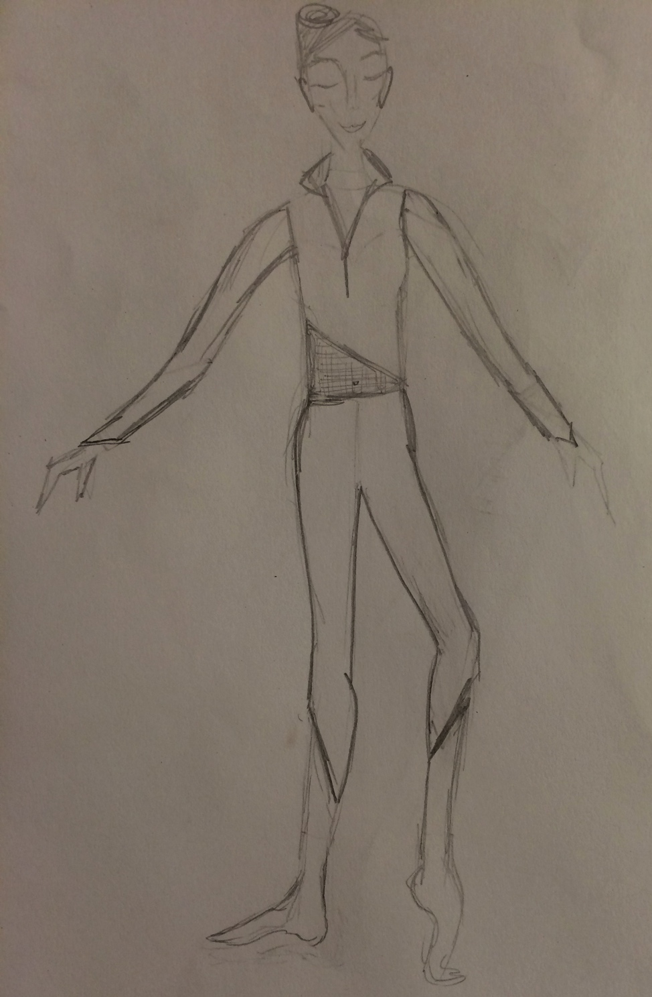
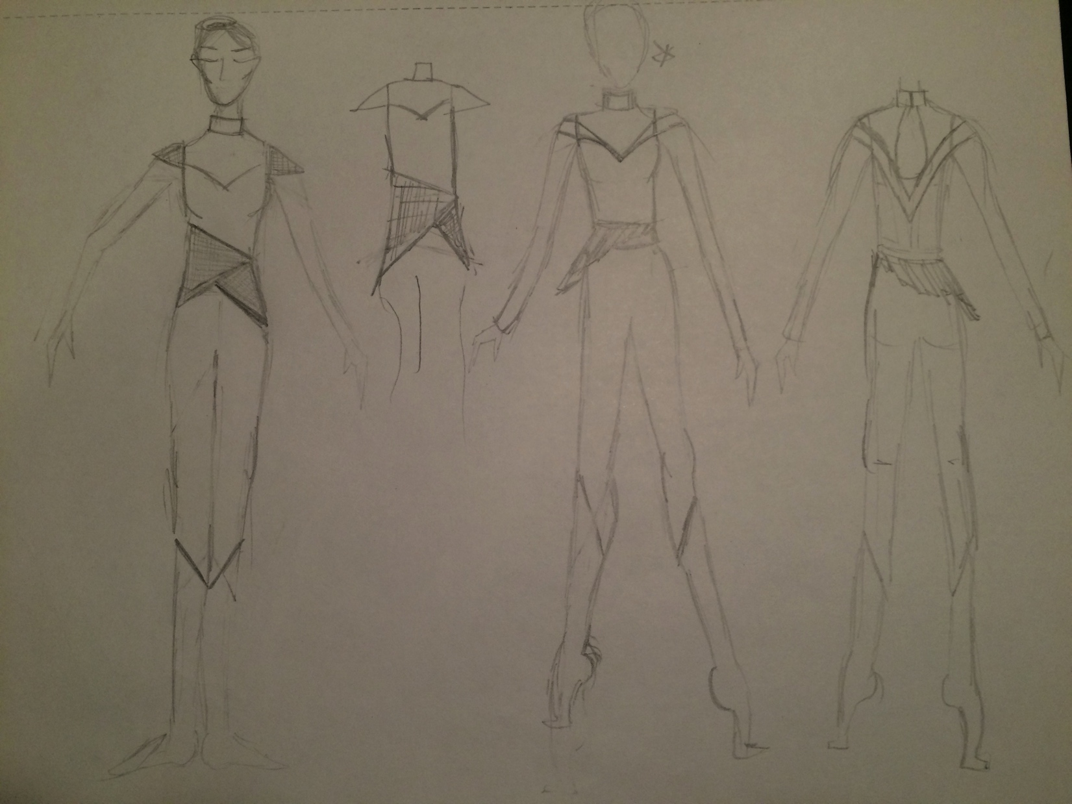
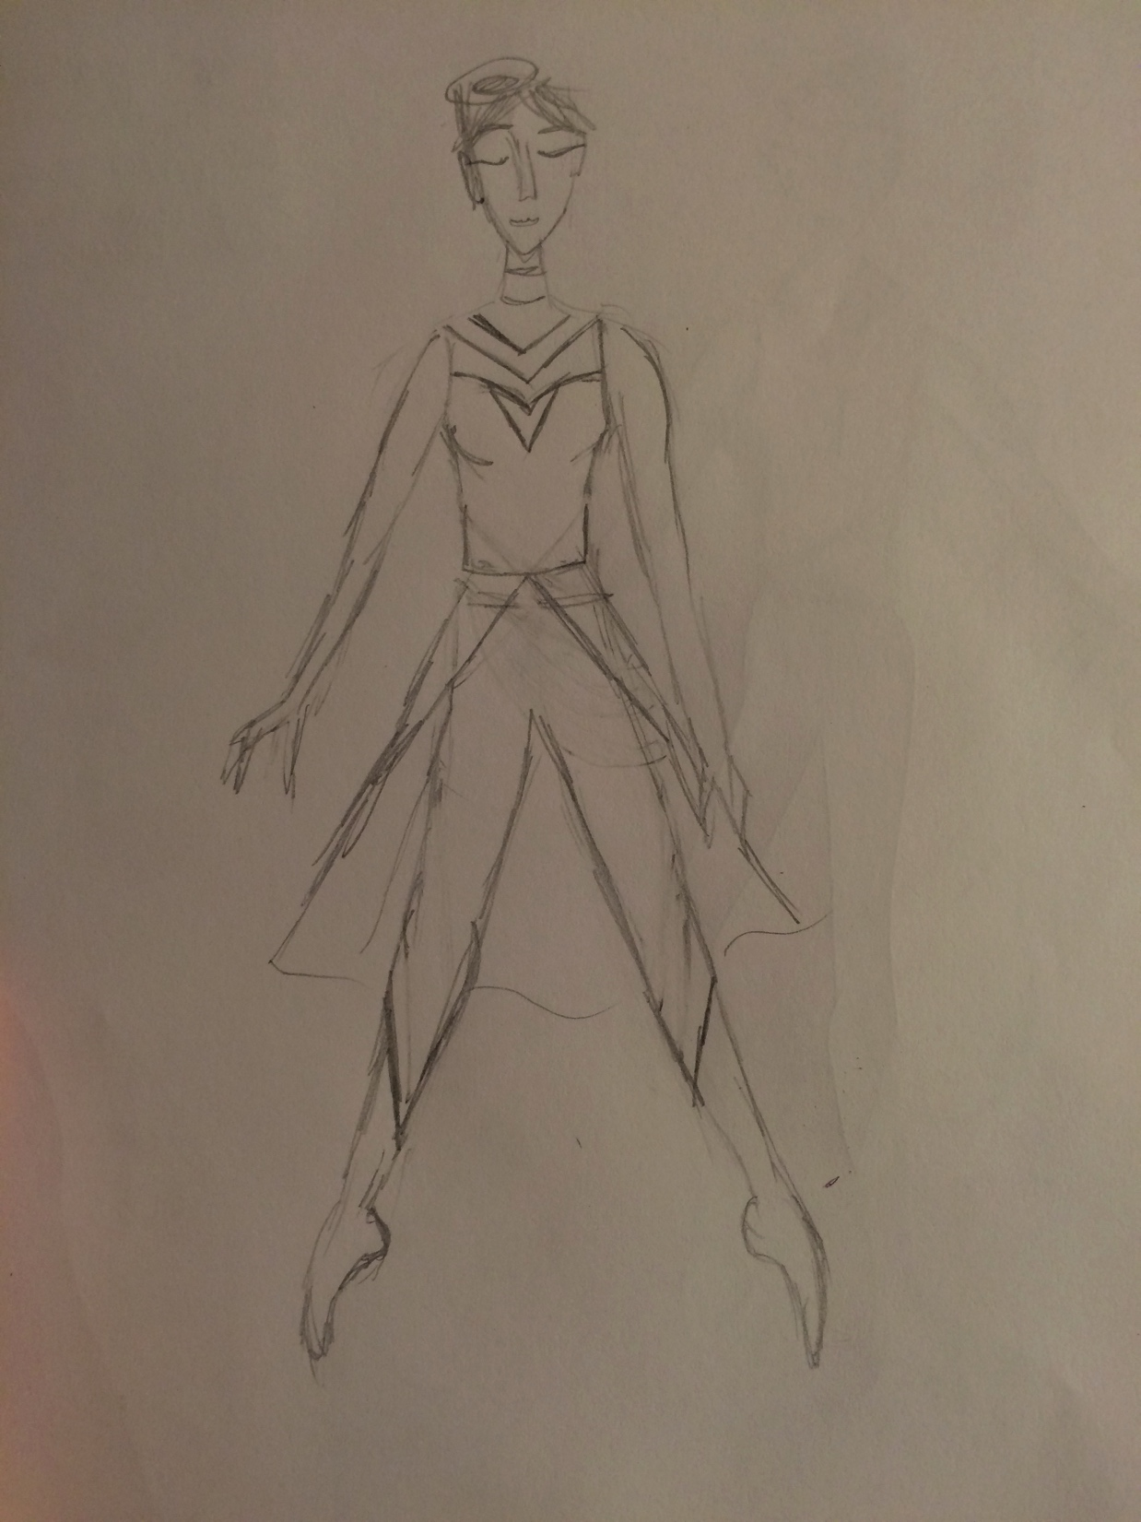
The Rehearsal Process: Costume Collaboration
Costumes:
Lauren Carmen
Sketches

Slide 13
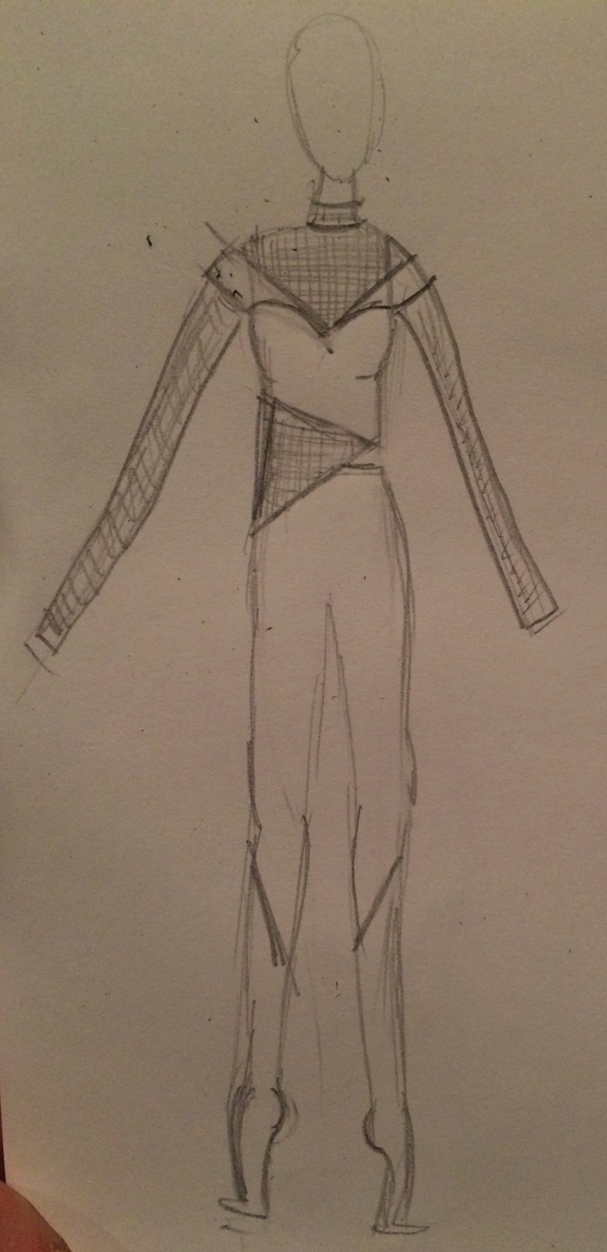
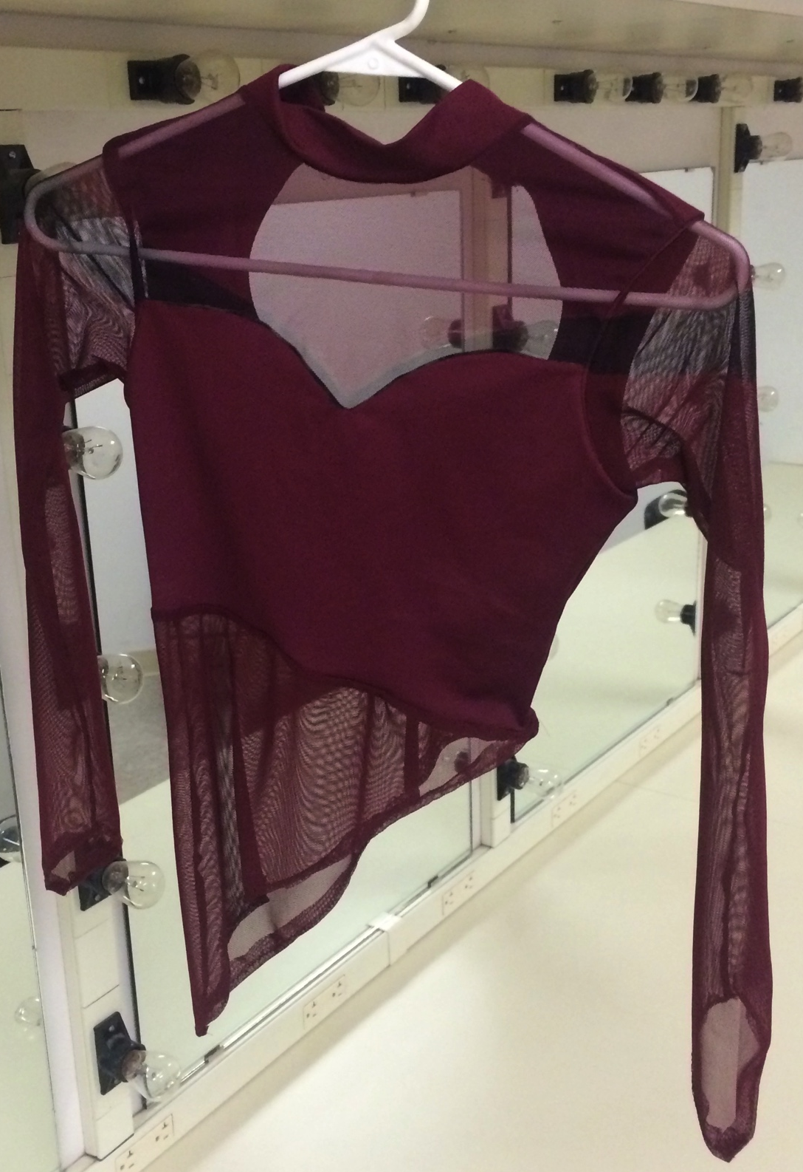
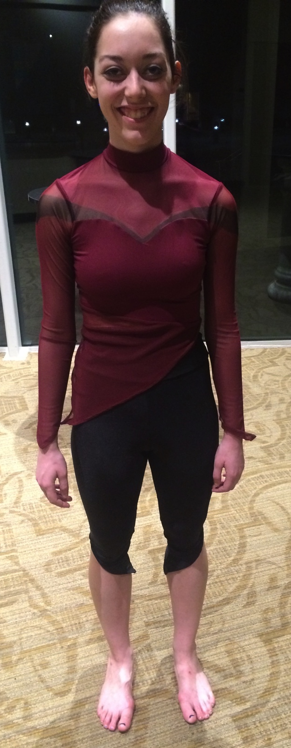
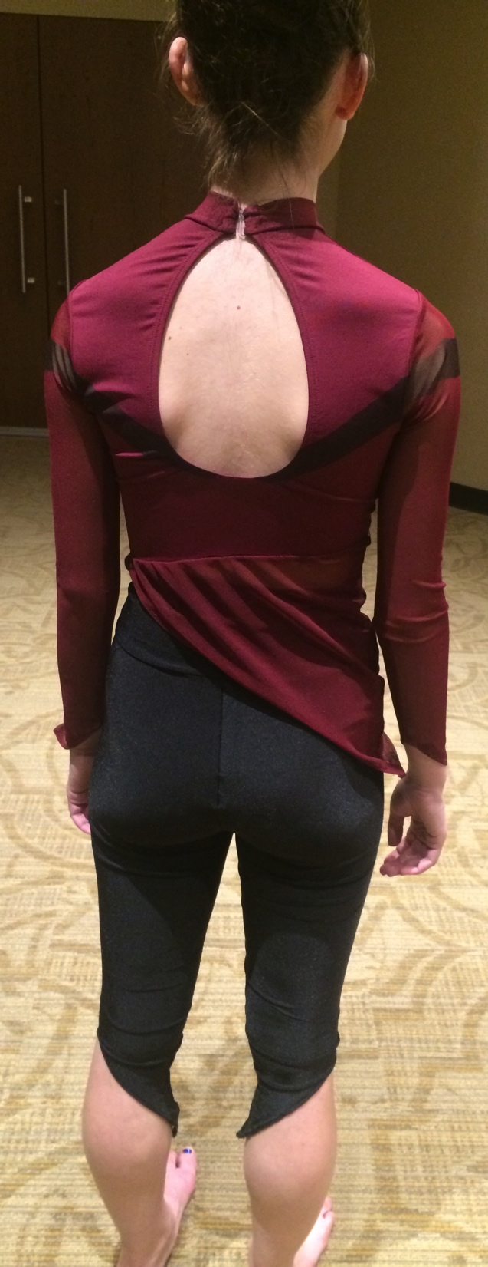
The Rehearsal Process: Costume Collaboration
Final Outcome:

Slide 14
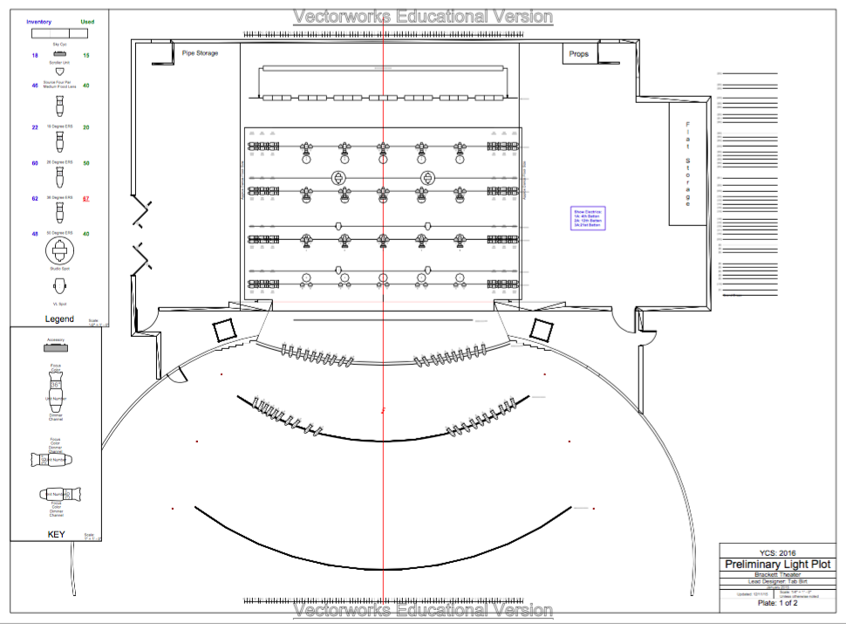
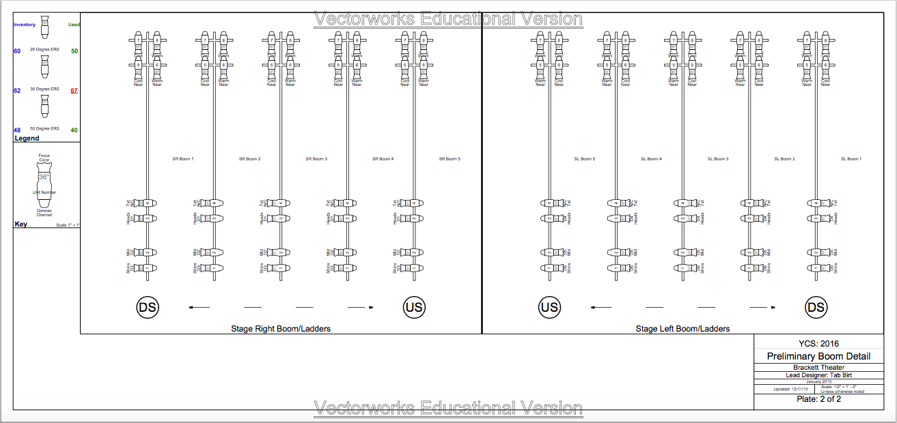
The Rehearsal Process: Lighting Collaboration
Lighting Designer:
Trevor Harris
Lighting Grid

Slide 15
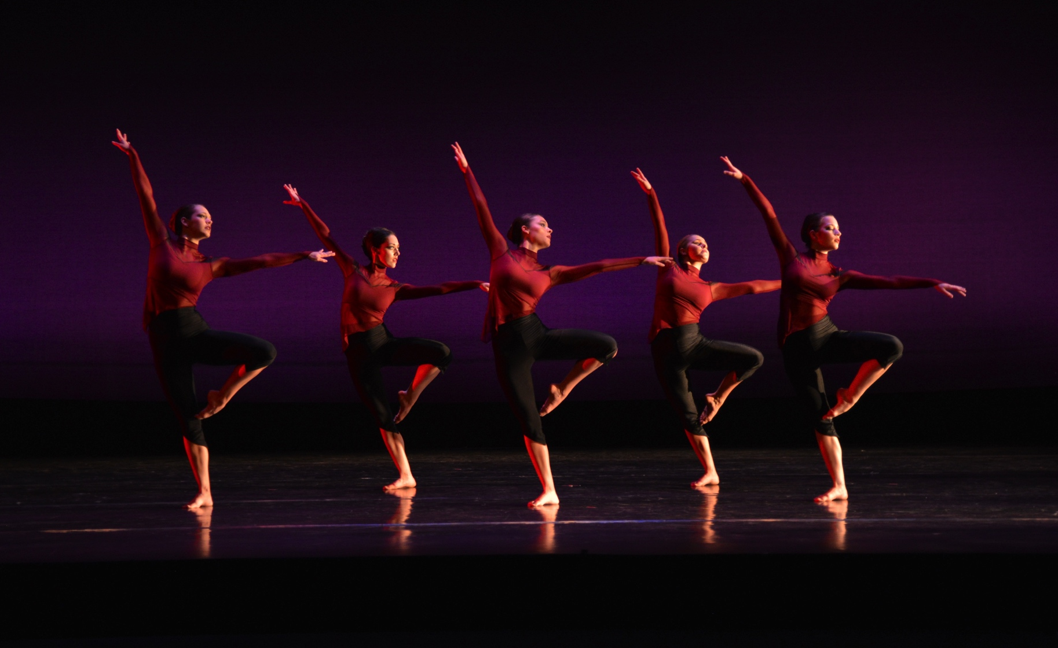
The Performance
Flash Drive or YouTube Link: (1:50)
https://youtu.be/ukaAHXxZ25c
Photo by: Kasey Allee-Foreman

Slide 16
Thank You
Ashley.E.Coffin-1@ou.edu

